Slide 1
Java Comments

Slide 2
Comments in Java
Java supports single-line and multi-line comments very similar to c and c++.
Comments are ignored by the java compiler

Slide 3
Types of Comments
Single line
Multi line
Documentation
// single line commnet
/*
Line 1
Line 2
*/
/**
This is documentation comments section
*/

Slide 4
Example
/**
*
* @author marepalli
* @date 08-10-2015
* @filename MyFirstJavaProgram.java
* @description To print HelloWorld message on console
*
*/
public class MyFirstJavaProgram{
/* This is my first java program.
* This will print 'Hello World' as the output
*/
public static void main(String []args){
// This is an example of single line comment
System.out.println("Hello World");
}
}

Slide 5
How to generate java documentation code
Shift + Alt + J → generates javadoc comments code

Slide 6
How to generate JavaDoc in Eclipse ?
In Java programming, we can use the javadoctool for generating API documentation from comments embedded in source code (Javadoc comments). However, it requires remembering various options of this tool, which is painful and time-consuming. Eclipse IDE can help to relieve this pain by providing the Javadoc Generation wizard.

Slide 7
Sample Javadoc comments:
/**
* Connects and logins to the FTP server.
*
* @throws FTPConnectionException If an I/O error occurs.
* @throws FTPLoginException If the login operation did not succeed.
*/
public void login() throws FTPConnectionException, FTPLoginException {
// method body
}

Slide 8
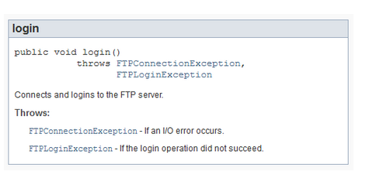
The generated documentation (in HTML format)

Slide 9
Steps in details.
In Eclipse IDE, select Generate Javadoc… from Project menu. The Javadoc Generation wizard appears as follows:

Slide 10
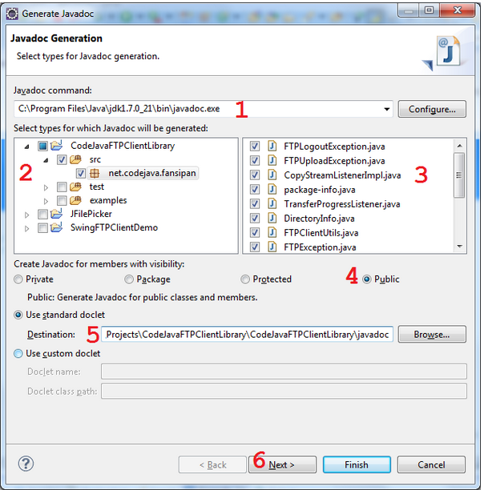

Slide 11
Specify location of the javadocprogram on your computer. Typically, it is located under JAVA_HOME’s bin directory. For example, C:\Program Files\Java\jdk1.7.0_21\bin\javadoc.exe, on Windows platform.
Select the project and packages for which you want to generate Javadoc.
Narrow down the source files whose Javadocs will be generated (All files are selected by default).
Limit what class members which will have Javadocs generated, by choosing the visibility (access modifier). For example: If Public is chosen, then only public methods will have Javadocs generated. If Protected is chosen, then only protected and public methods will have Javadocs generated, and so on.
Specify the destination directory where the Javadocs will be put in.
Click Next.

Slide 12
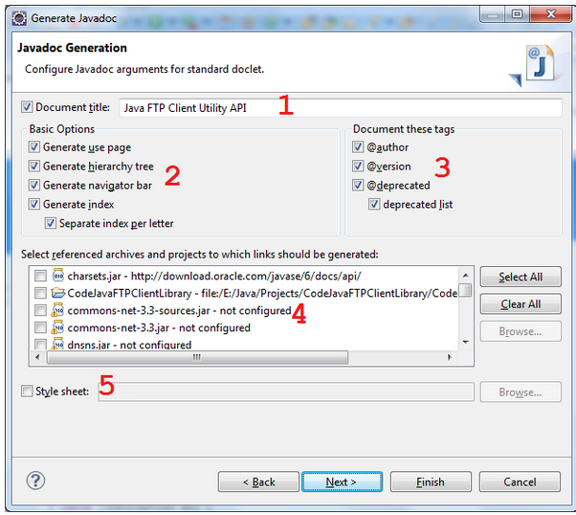
The next screen allows us to specify some arguments and options for the javadoc tool, such as document title (1); document structure (2); documenting tags (3); JAR files and projects to which referenced links are generated (4); and stylesheet for the document (5):
At least you should specify the document title, leave others as default, and then click Next.

Slide 13
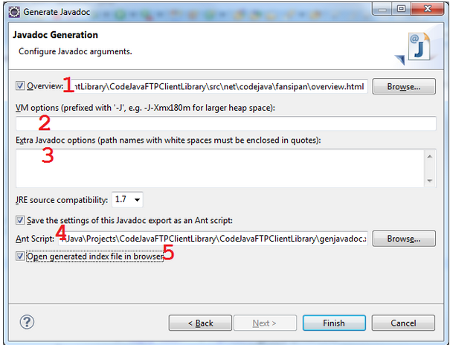
document (1); VM options (2); Extra javadoc options (3):
If you want to reuse the settings for future exports (recommended), check the option “Save the settings of this Javadoc export as an Ant script” (4) and specify the location of the generated Ant build file. This option would be helpful as we tend to generate the Javadocs many times when the project evolves.
If the option “Open generated index file in browser” (5) is checked, then Eclipse will open the generated document in its internal web browser.
Click Finish

Slide 14
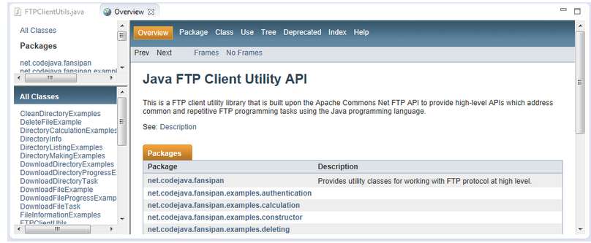
Sample output

Slide 15
Creating API Document | javadoc tool
We can create document api in java by the help of javadoc tool. In the java file, we must use the documentation comment /**... */ to post information for the class, method, constructor, fields etc.

Slide 16
Example: Simple class that contains documentation comments
package com.abc;
/** This class is a user-defined class that contains one methods cube.*/
public class M{
/** The cube method prints cube of the given number */
public static void cube(int n){System.out.println(n*n*n);}
}

Slide 17
Create document API
Use the javadoc tool followed by java file name. There is no need to compile the javafile.
On the command prompt write javadoc M.java
there will be created a lot of html files. Open the index.html file to get the information about the classes.

Slide 18
Javadoc Tool
Javadoc is a tool for generating API documentation in HTML format from doc comments in source code.

Slide 19
Quiz

Slide 20
Queries???

Slide 21
Assignment

